Slide 1
Kubernetes and container
Zhiyue Qiu
Notes:
Today I am going to give a representation on Kubernetes.
Kubernetes is an open-source system for automating deployment, scaling, and management of containerized applications. It groups containers that make up an application into logical units for easy management and discovery.
it evolves during the last 15 years, it is a pretty mature and large project. So I only think about
What problem does this project intend to solve? What kind of existing technologies are involved? I think that is a guideline for studying a huge project.

Slide 2
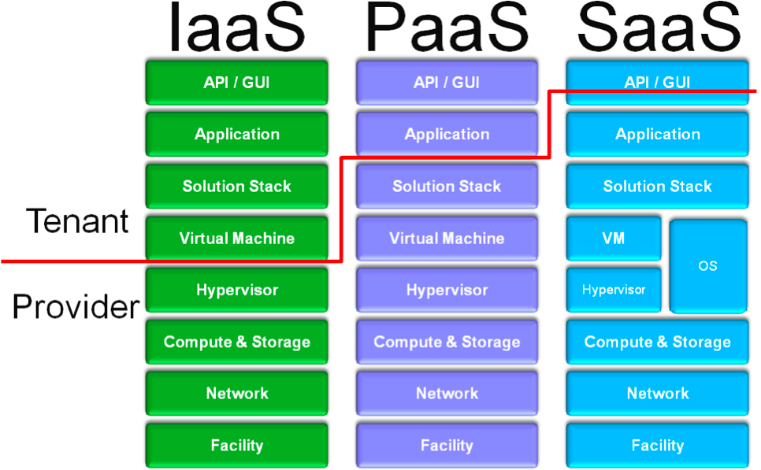
Issues of cloud provider
Resource pooling, Isolation and multitenancy layer.
Notes:
The definition of cloud is “resource pooling” where the “provider’s computing resources are pooled to serve multiple consumers using a multitenant model, with different physical and virtual resources dynamically assigned and reassigned according to consumer demand.

Slide 3
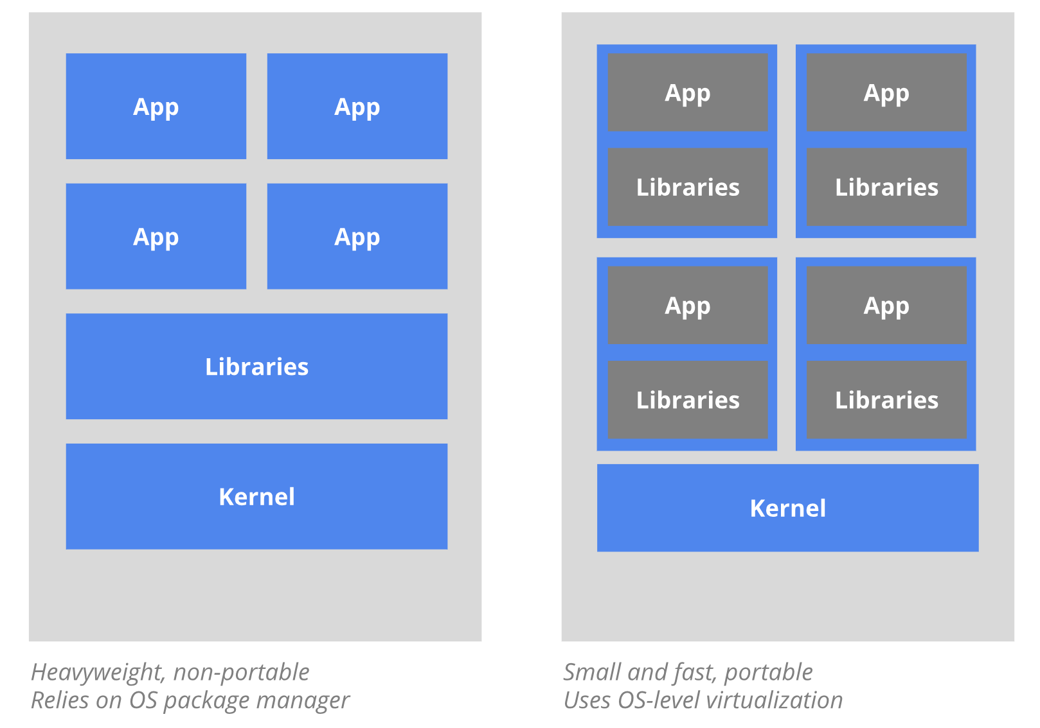
Hypervisor vs Container
Notes:
Two technologies are commonly used here: the hypervisor and the container.
hypervisor provides for virtual machines
LXC (LinuX Containers) is a OS-level virtualization technology that allows creation and running of multiple isolated Linux virtual environments (VE) on a single control host.
Docker is a tool designed to make it easier to create, deploy, and run applications by using containers. Containers allow a developer to package up an application with all of the parts it needs, such as libraries, other dependencies, CPU and memory,, and ship it all out as one package.

Slide 4
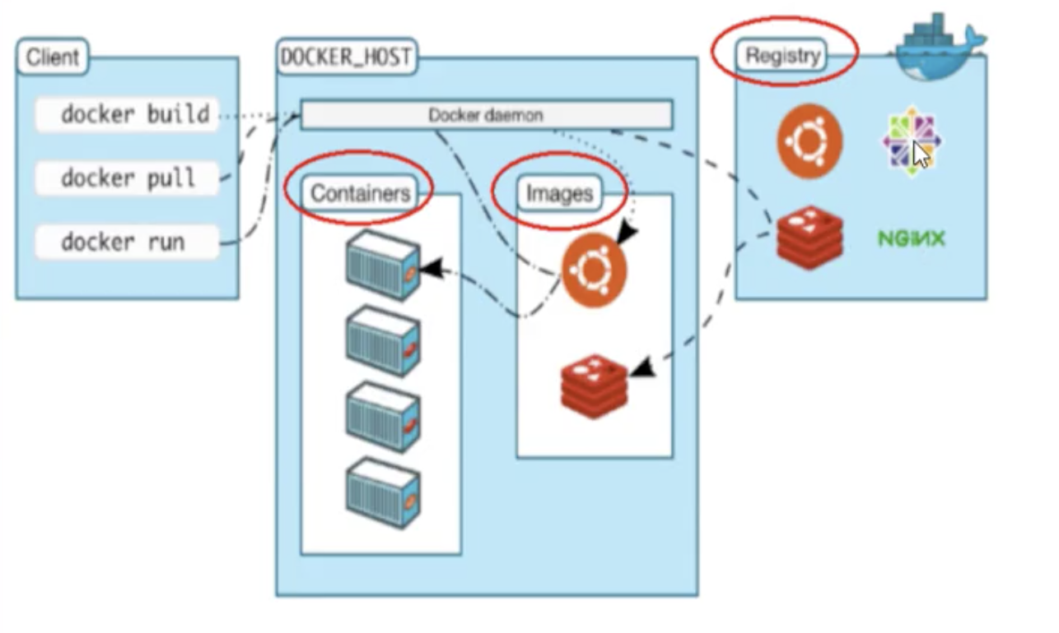

Slide 5
Kubernetes:
Kubernetes is a portable, extensible open-source platform for managing containerized workloads and services, that facilitates both declarative configuration and automation. It has a large, rapidly growing ecosystem. Kubernetes services, support, and tools are widely available.
Notes:
Today I am going to give a representation on Kubernetes.
Kubernetes is an open-source system for automating deployment, scaling, and management of containerized applications. It groups containers that make up an application into logical units for easy management and discovery.
it evolves during the last 15 years, it is a pretty mature and large project. So I only think about
What problem does this project intend to solve? What kind of existing technologies are involved? I think that is a guideline for studying a huge project.

Slide 6
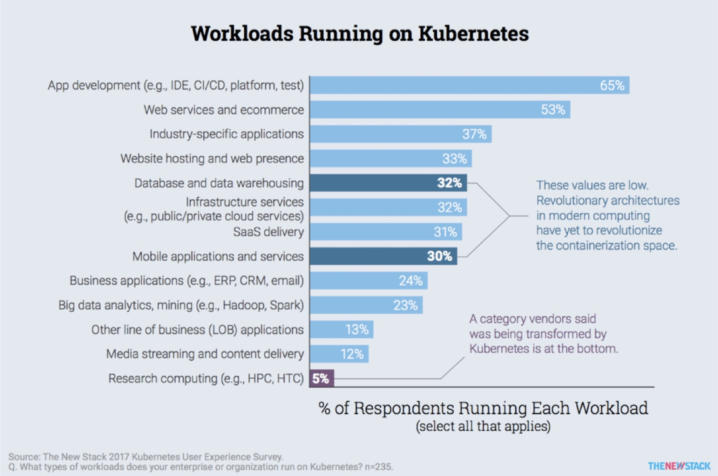

Slide 7
DevOps
Monitoring, logging
CI/CD (continuous integration, continuous delivery)

Slide 8
FaaS(serverless application)
google bigquery vs HDFS spark

Slide 9
Storage system
kubernetes is for container orchestration

Slide 10
CRI, CNI, CSI
container runtime interface
container network interface
container storage interface

